Slide 1
Micah’s Random Survey Responses
Micah Coffey

Slide 2
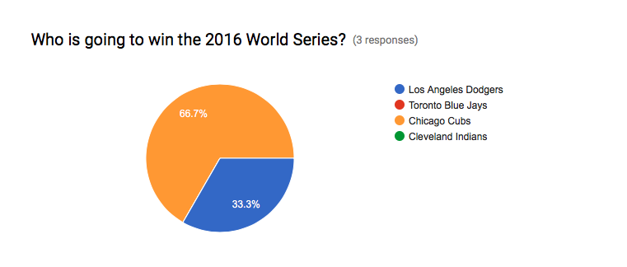

Slide 3
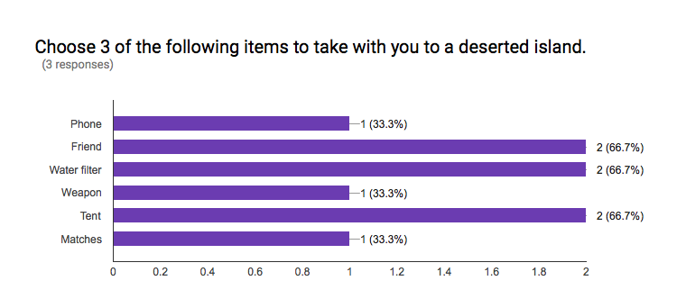

Slide 4
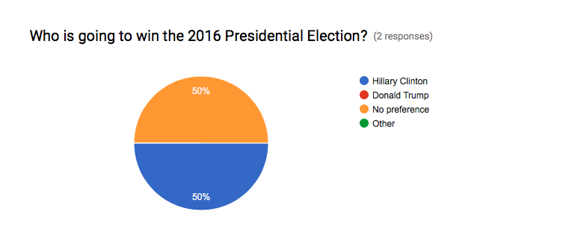

Slide 5


Slide 6


Slide 7
